Slide 1
Variable Damping Analysis of Smart Suspension System in a Car
Presented by
Rishavdeb ghosh 234103108
Yesto zhimo 234103446
d.Rajanikanth 234103416
B Shashi Preetham 234103436

Slide 2
INTRODUCTION
Road undulation is a case of random vibration time period.
The time and frequency domains are alternative ways of representing signals. The Fourier transform is the mathematical relationship between these two representations. If a signal is modified in one domain, it will also be changed in the other domain, although usually not in the same way
For a non periodic function time period can be assumed to be infinity, Fourier series of it gives the various frequency spectrum present in it along with the magnitude of it.we can break it into different sine and cosine frequencies which further can be analysed easily using our regular approach in vibration
We can also analyse the random road surface using series of impulses then ploting the response of the vehicle.

Slide 3
ABSTRACT
When travelling, vehicles experience dynamic excitations of varying magnitudes. Such excitations could lead to induced vibration, which affect the vehicles integrity and occupants. The suspension system reduces the effect of vibration caused by the road and driving conditions. The car along with tyres is modelled as 4 degrees of freedom . The car body is modelled as a structure consist of plate and tyres attached to it at bottom corners. We may use MR Fluids to change damping effects and hence control the vibration to our comfort.

Slide 4
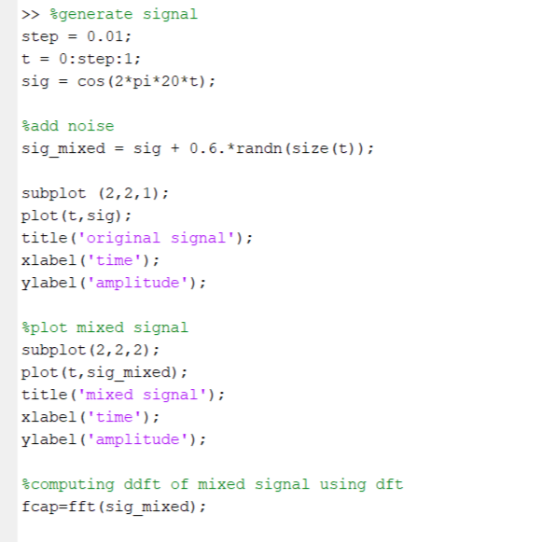
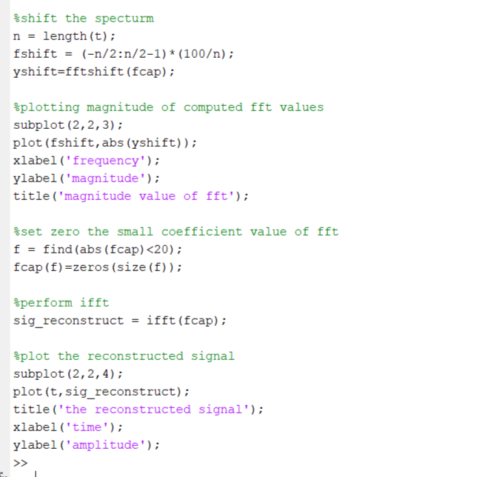
MATLAB CODE

Slide 5
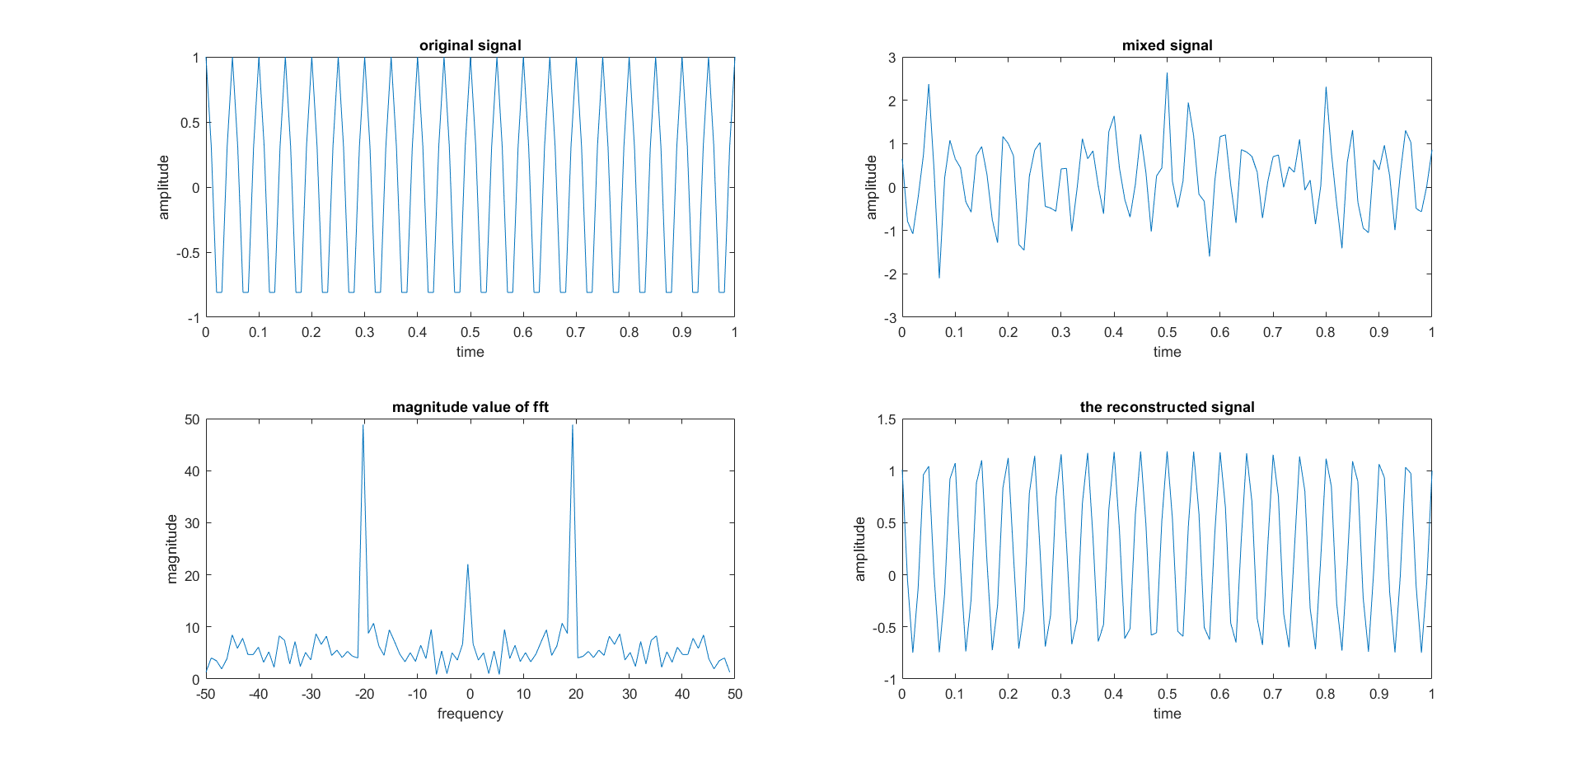
RESULTS FROM MATLAB CODE

Slide 6
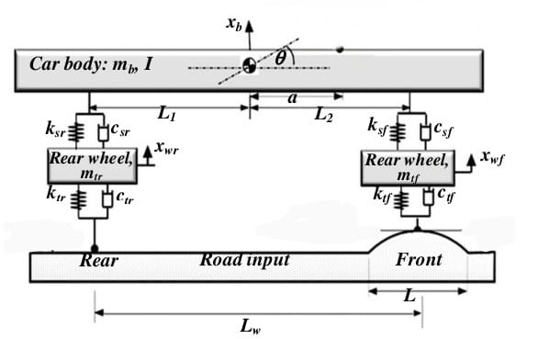
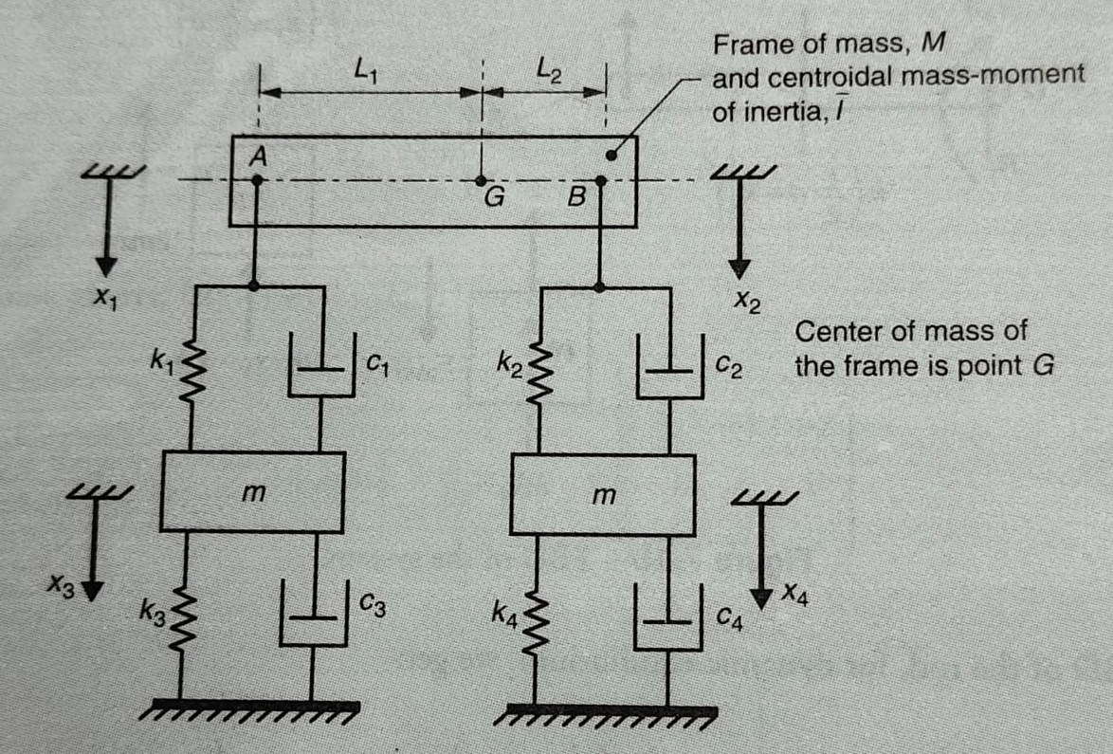
MODEL OF SYSTEM

Slide 7
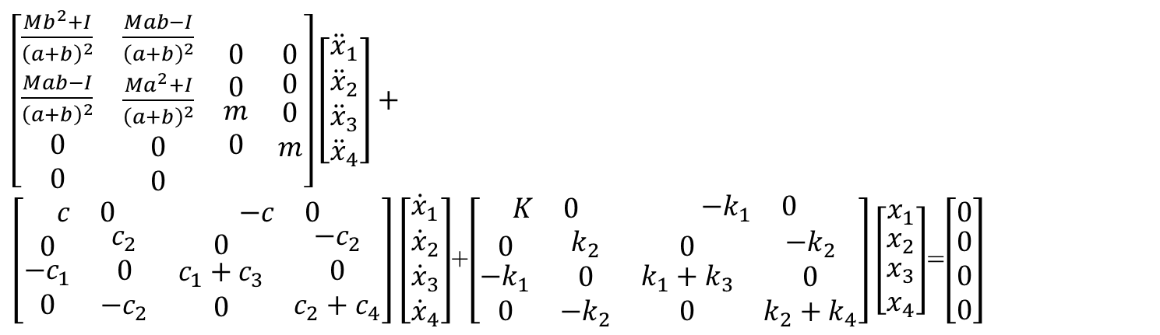
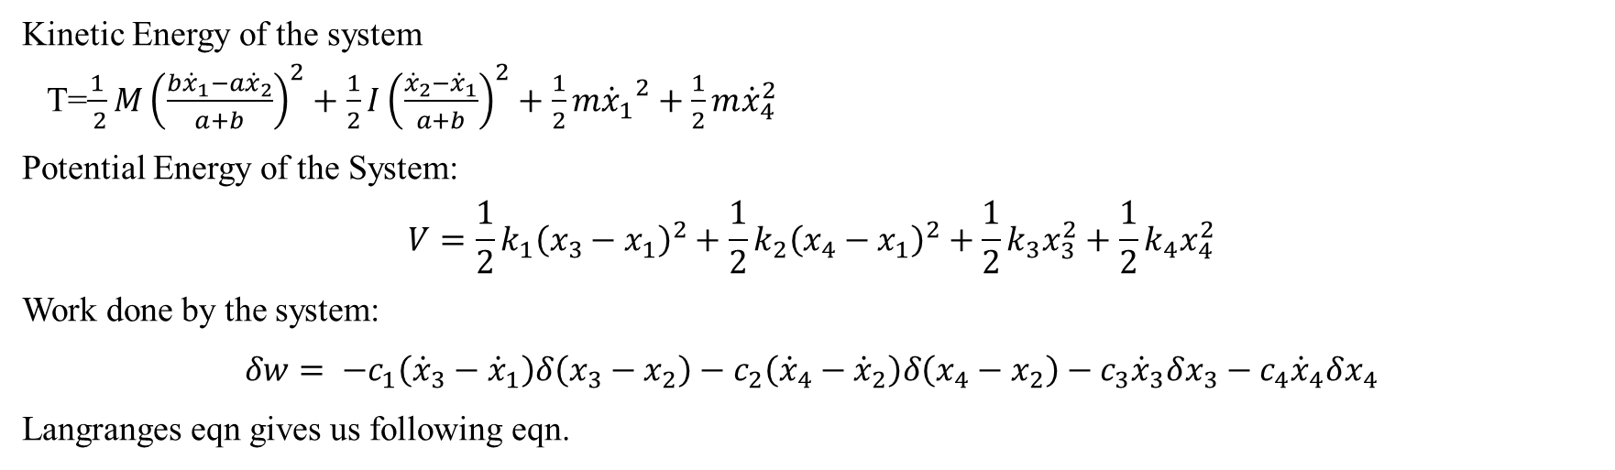
Kinetic Energy of the system T=$\frac{1}{ 2}M{\left(\frac{{b\dot{x}}_{1}−a{\dot{x}}_{2}}{a+b}\right)}^{2}+\frac{1}{2}I{\left(\frac{{\dot{x}}_{2}−{\dot{x}}_{1}}{a+b}\right)}^{2}+\frac{1}{2}{m{\dot{x}}_{1}}^{2}+{\frac{1}{2}m\dot{x}}_{4}^{2}$
Potential Energy of the System: $$V={\frac{1}{2}k}_{1}{\left(x_{3}−x_{1}\right)}^{2}+\frac{1}{2}{k_{2}\left(x_{4}−x_{1}\right)}^{2}+{{\frac{1}{2}k}_{3}x}_{3}^{2}+{{\frac{1}{2}k}_{4}x}_{4}^{2}$$
Work done by the system:
$$δw= −c_{1}\left({\dot{x}}_{3}−{\dot{x}}_{1}\right)δ\left(x_{3}−x_{2}\right)−c_{2}\left({\dot{x}}_{4}−{\dot{x}}_{2}\right)δ\left(x_{4}−x_{2}\right)−c_{3}{\dot{x}}_{3}δx_{3}−c_{4}{\dot{x}}_{4}δx_{4}$$
Langranges eqn gives us following eqn.
$\left[\begin{matrix}\begin{matrix}\frac{Mb^{2}+I}{{\left(a+b\right)}^{2}} & \frac{Mab−I}{{\left(a+b\right)}^{2}} \\ \begin{matrix}\frac{Mab−I}{{\left(a+b\right)}^{2}} \\ \begin{matrix}0 \\ 0\end{matrix}\end{matrix} & \begin{matrix}\frac{Ma^{2}+I}{{\left(a+b\right)}^{2}} \\ \begin{matrix}0 \\ 0\end{matrix}\end{matrix}\end{matrix} & \begin{matrix}0 & 0 \\ \begin{matrix}0 \\ \begin{matrix}m \\ 0\end{matrix}\end{matrix} & \begin{matrix}0 \\ \begin{matrix}0 \\ m\end{matrix}\end{matrix}\end{matrix}\end{matrix}\right]\left[\begin{matrix}{\ddot{x}}_{1} \\ \begin{matrix}{\ddot{x}}_{2} \\ \begin{matrix}{\ddot{x}}_{3} \\ {\ddot{x}}_{4}\end{matrix}\end{matrix}\end{matrix}\right]+\left[\begin{matrix}\begin{matrix}c & 0\end{matrix} & \begin{matrix}−c & 0\end{matrix} \\ \begin{matrix}\begin{matrix}0 \\ \begin{matrix}{−c}_{1} \\ 0\end{matrix}\end{matrix} & \begin{matrix}c_{2} \\ \begin{matrix}0 \\ −c_{2}\end{matrix}\end{matrix}\end{matrix} & \begin{matrix}\begin{matrix}0 \\ \begin{matrix}c_{1}+c_{3} \\ 0\end{matrix}\end{matrix} & \begin{matrix}−c_{2} \\ \begin{matrix}0 \\ c_{2}+c_{4}\end{matrix}\end{matrix}\end{matrix}\end{matrix}\right]\left[\begin{matrix}{\dot{x}}_{1} \\ \begin{matrix}{\dot{x}}_{2} \\ \begin{matrix}{\dot{x}}_{3} \\ {\dot{x}}_{4}\end{matrix}\end{matrix}\end{matrix}\right]$+$\left[\begin{matrix}\begin{matrix}K & 0\end{matrix} & \begin{matrix}{−k}_{1} & 0\end{matrix} \\ \begin{matrix}\begin{matrix}0 \\ \begin{matrix}{−k}_{1} \\ 0\end{matrix}\end{matrix} & \begin{matrix}k_{2} \\ \begin{matrix}0 \\ −k_{2}\end{matrix}\end{matrix}\end{matrix} & \begin{matrix}\begin{matrix}0 \\ \begin{matrix}k_{1}+k_{3} \\ 0\end{matrix}\end{matrix} & \begin{matrix}−k_{2} \\ \begin{matrix}0 \\ k_{2}+k_{4}\end{matrix}\end{matrix}\end{matrix}\end{matrix}\right]\left[\begin{matrix}x_{1} \\ \begin{matrix}x_{2} \\ \begin{matrix}x_{3} \\ x_{4}\end{matrix}\end{matrix}\end{matrix}\right]$=$\left[\begin{matrix}0 \\ \begin{matrix}0 \\ 0 \\ 0\end{matrix}\end{matrix}\right]$

Slide 8
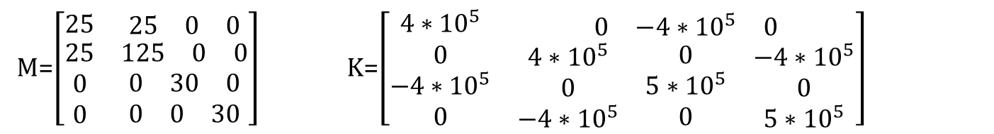
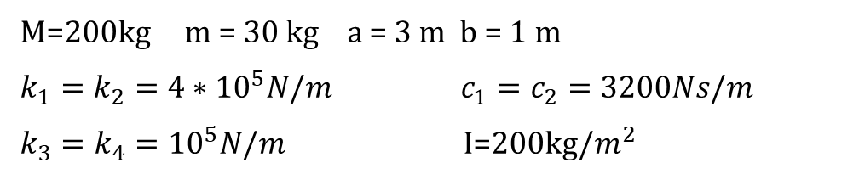
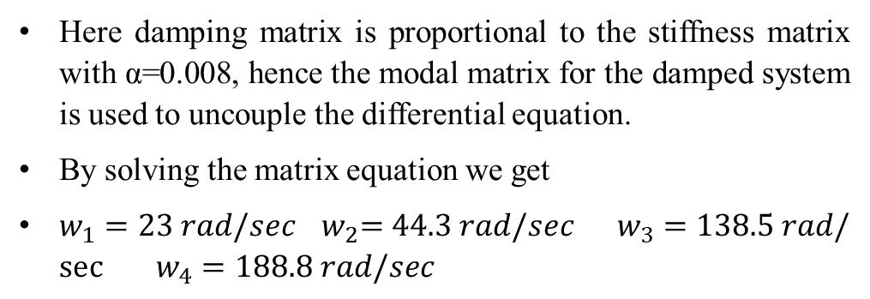
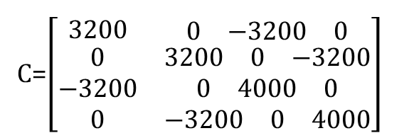
M=200kg m = 30 kg a = 3 m b = 1 m
$k_{1}=k_{2}=4∗{10}^{5}N/m$ $c_{1}=c_{2}=3200Ns/m$
$k_{3}=k_{4}={10}^{5}N/m$ I=200kg/$m^{2}$
M=$\left[\begin{matrix}25 & \begin{matrix}25 & 0 & 0\end{matrix} \\ \begin{matrix}25 \\ 0 \\ 0\end{matrix} & \begin{matrix}\begin{matrix}125 & 0 & 0\end{matrix} \\ \begin{matrix}0 & 30 & 0\end{matrix} \\ \begin{matrix}0 & 0 & 30\end{matrix}\end{matrix}\end{matrix}\right]$ K=$\left[\begin{matrix}4∗{10}^{5} & \begin{matrix}0 & −4∗{10}^{5} & 0\end{matrix} \\ \begin{matrix}0 \\ −4∗{10}^{5} \\ 0\end{matrix} & \begin{matrix}\begin{matrix}4∗{10}^{5} \\ 0 \\ −4∗{10}^{5}\end{matrix} & \begin{matrix}0 \\ 5∗{10}^{5} \\ 0\end{matrix} & \begin{matrix}−4∗{10}^{5} \\ 0 \\ 5∗{10}^{5}\end{matrix}\end{matrix}\end{matrix}\right]$
Here damping matrix is proportional to the stiffness matrix with α=0.008, hence the modal matrix for the damped system is used to uncouple the differential equation.
By solving the matrix equation we get
$w_{1}=23 rad/sec$ ${ w}_{2}=44.3 rad/sec$ $w_{3}=138.5 rad/\sec{ }w_{4}=188.8 rad/sec$
C=$\left[\begin{matrix}3200 & \begin{matrix}0 & −3200 & 0\end{matrix} \\ \begin{matrix}0 \\ −3200 \\ 0\end{matrix} & \begin{matrix}\begin{matrix}3200 & 0 & −3200\end{matrix} \\ \begin{matrix}0 & 4000 & 0\end{matrix} \\ \begin{matrix}−3200 & 0 & 4000\end{matrix}\end{matrix}\end{matrix}\right]$

Slide 9
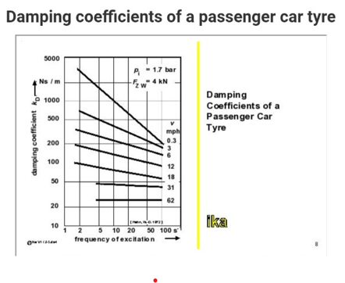

Slide 10
MR FLUIDS
Suspension of magnetically responsive particles in a liquid carrier.
They possess ability to change from a free flowing liquid into semi solid when exposed to externally magnetic field.
Damping properties of MR Fluids can be changed using external magnetic fluid.
Possess potential for applications like dampers, shock absorbers, clutches, brakes etc in automobiles.

Slide 11
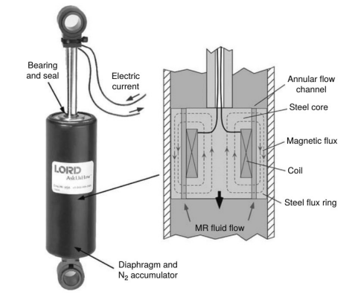
BASIC MR FLUID DAMPER

Slide 12
CONCLUSION :
Ratio obtained between excitation frequency and natural frequencies is no where near 1.
There may be cases where the ratio will be close to 1. In such cases one may use smart materials like MR Fluids to vary damping.

